Slide 1
Persona AI Assistant By Jean-Denis DRANE
Ironhack AI Bootcamp
May-July2025

Slide 2
Why this is awesome?
AI assistant with 6 distinct personalities (tech, finance, data science, startup, security, education)
Accessible through text & voice
Smart memory & video/documentation integration
Deployed and ready for real-world use!

Slide 3
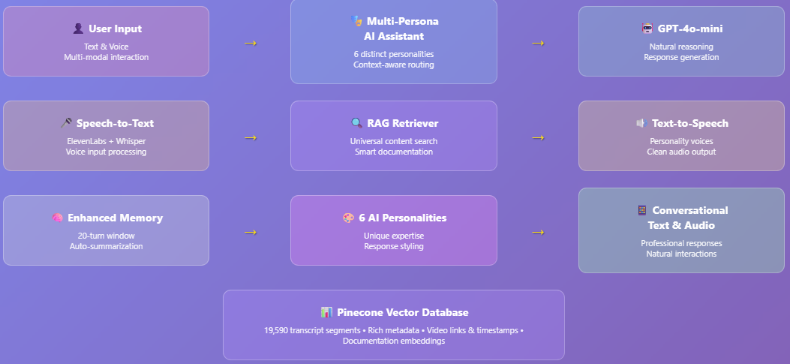
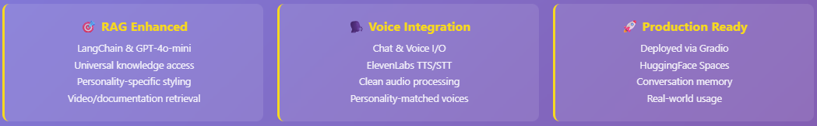
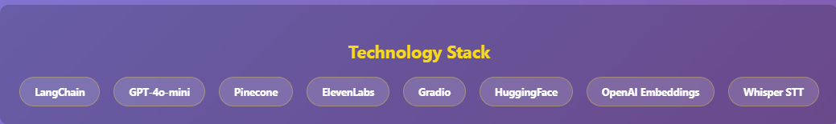
Architecture

Slide 4
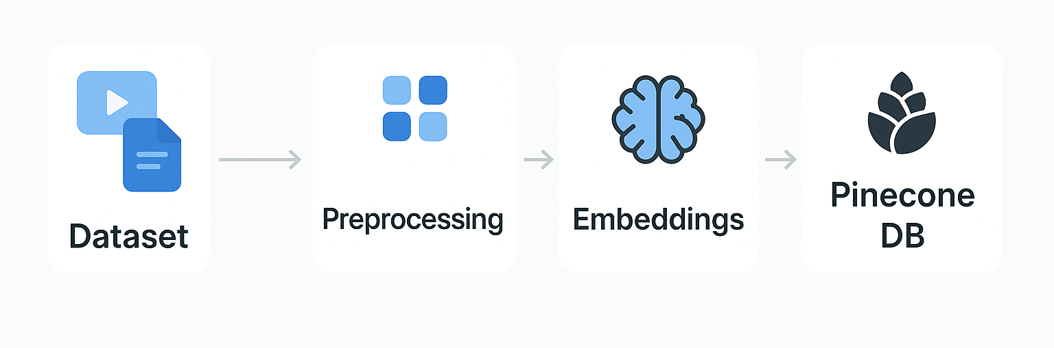


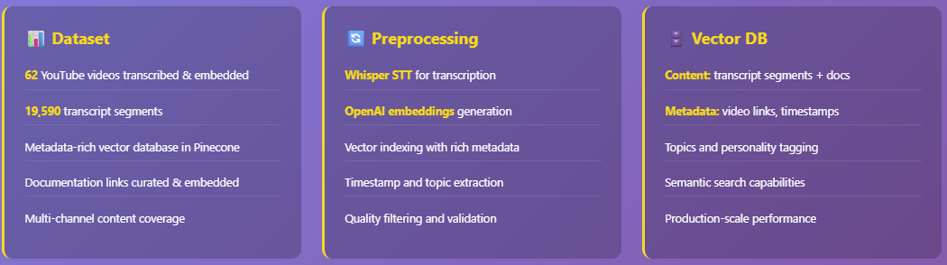
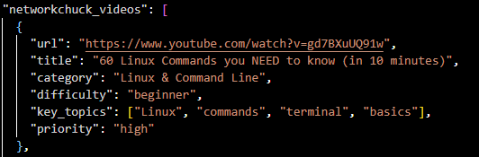
Technical summary

Slide 5
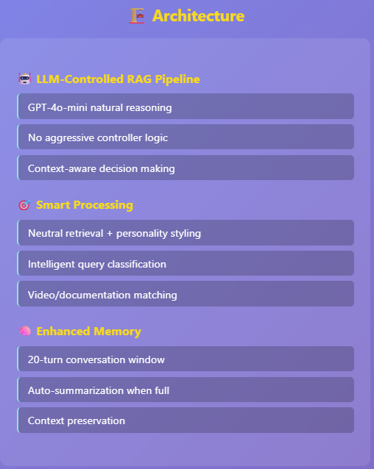
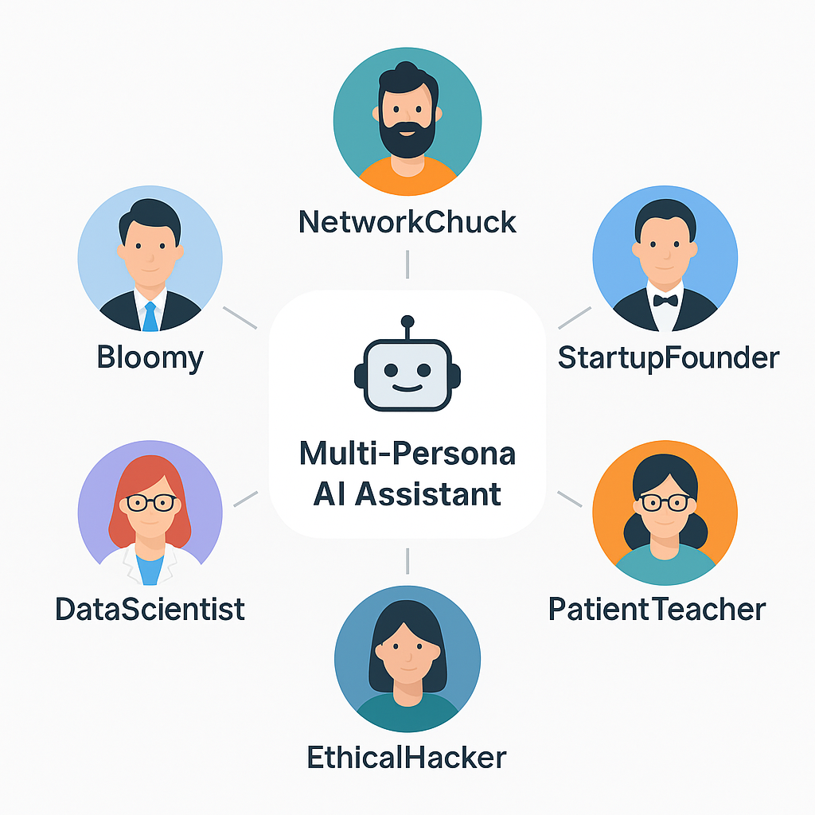
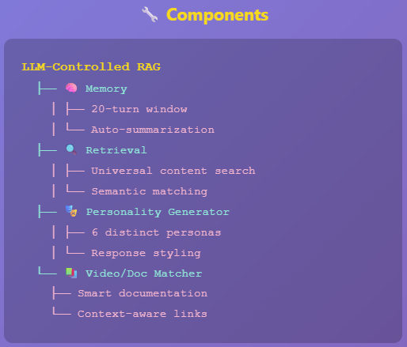
Q&A Agent

Slide 6
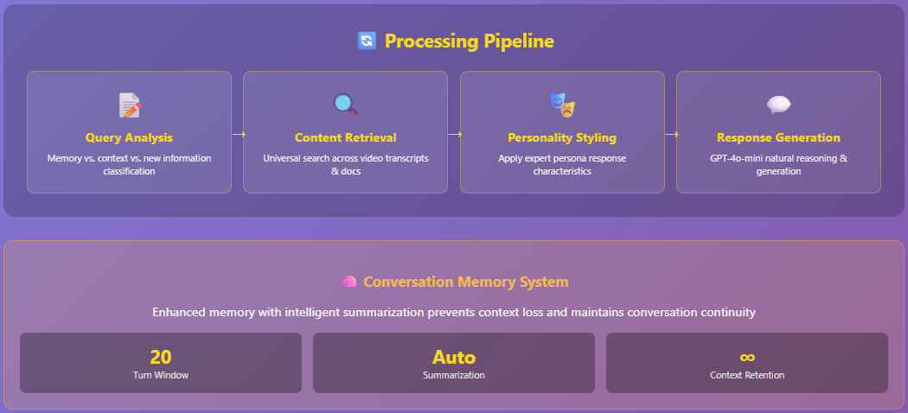
Q&A Agent

Slide 7
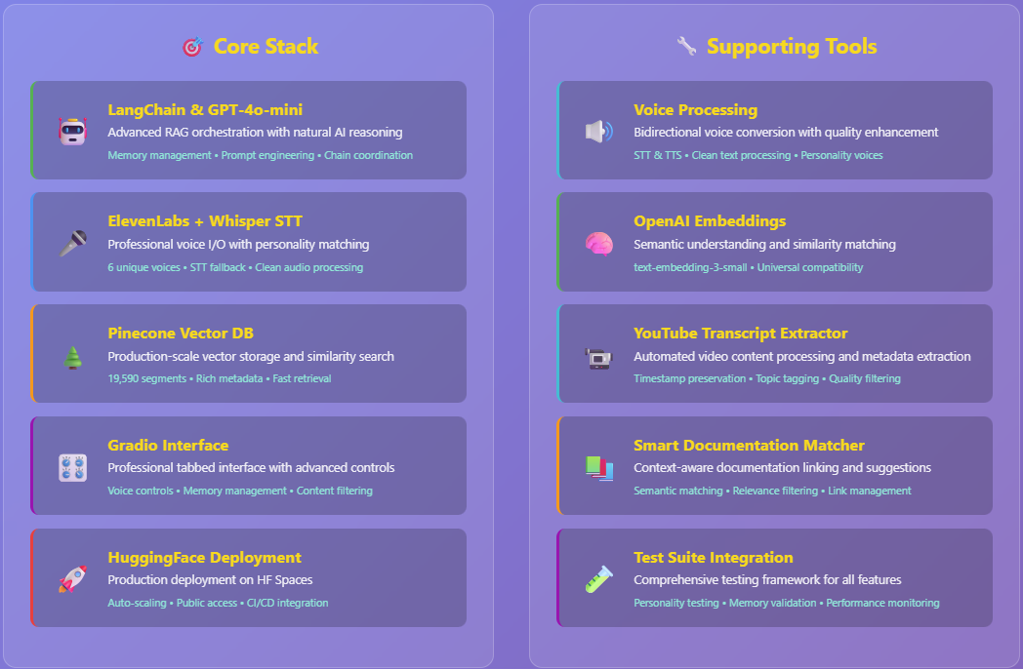
Tools

Slide 8
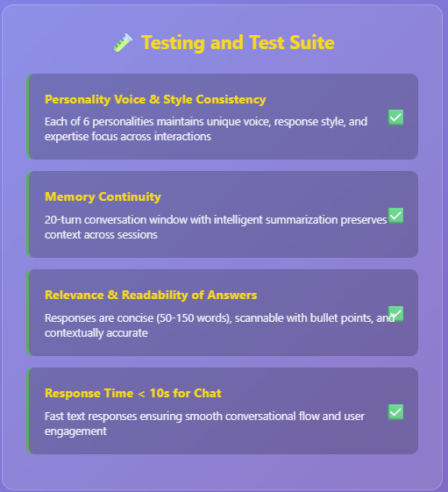
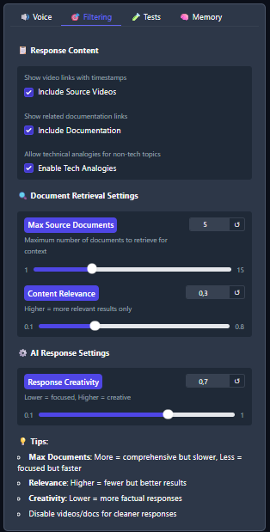
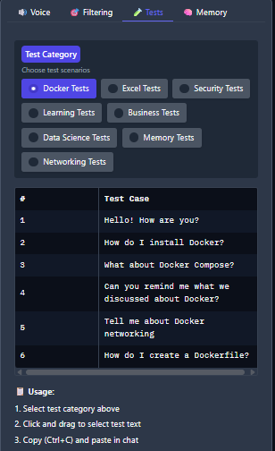
Evaluation

Slide 9
Conclusion Production-ready, customizable AI assistant with dual text & voice interaction
Technical
6 distinct expert personalities
Enhanced memory (20-turn + summarization)
Professional voice integration
GPT-4o-mini natural reasoning
Production Impact
Live deployment on HuggingFace
Real-world user accessibility
Scalable, maintainable architecture
6
AI Personalities
19K+
Knowledge Segments
<10s
Response Time
Live
Deployment
"Advanced AI that doesn't just answer questions—it teaches, adapts, and remembers like a human expert, making sophisticated technology accessible through natural conversation."

Slide 10
Demo
https://huggingface.co/spaces/JeanDenisD/multi-persona-ai-assistant

Slide 11
Thanks!

